Slide 1
BELARUSIAN STATE UNIVERSITY
OF INFORMATICS AND RADIOELECTRONICS
Outputs of TEMPUS project
«Promoting Internationalisation of HEIs in Eastern Neighbourhood Countries through Cultural and Structural Adaptations»
within December 2013 – June 2016
Elena Bakunova, oms@bsuir.by

Slide 2
PICASA: BSUIR OUTPUTS
WP1: Institutional capacity building
1.2.Training of administrative & academic staff
Administrative staff training in Graz done on 27-31.05.2014, A.Osipov, First Vice-Rector, E.Bakunova, IRO Head
Academic staff training in Leuven done on 17-21.06.2014, U.Parkhimenka, Economics Dpt. Head, N.Nasonova, Ass. Professor of Information Security Dpt.
1.3.Revision of the functions and role of international affairs unit
Done on 04-23.09.2014 by International Office staff
1.4.Purchase of equipment and software
Not done yet, scheduled for 2016

Slide 3
PICASA: BSUIR OUTPUTS
WP2: Development of internationalization framework
2.1.Concept paper on internationalization of HEIs
Benchmarking of approaches to internationalization done on 05.05-16.05.2014, A.Osipov, IRO staff, U.Parkhimenka, N.Nasonova
2.2.New strategies and policies on internationalization
Workshop for developing strategies and policies in Genoa done on 23-27.11.2014, A.Osipov, E.Bakunova
Experts’ site visit to BSUIR done on 22-27.03.2015, B.Middlemas, PICASA Local Coordinator, Roehampton University, UK
Development of BSUIR Policy on Internationalization & its integration into BSUIR Development Programme for years 2016-2020 (01-12.2015)

Slide 4
PICASA: РЕЗУЛЬТАТЫ БГУИР
WP2: Development of internationalization framework
2.2. New strategies and policies on internationalization
Development of new Belarusian NQF based on ISCED-2013
Development of local acts regulating:
- student exchange between BSUIR and L.N.Gumilyov Eurasian National University (Kazakhstan)
competitive selection of participants for Erasmus+, КА1
2.4. In-house trainings
Info-seminar for BSUIR students and staff “Study&Research Opportunities in Germany” (29.09.2015 г.)
Trainings for BSUIR Master students and academic staff preparing for internships abroad

Slide 5
PICASA: BSUIR OUTPUTS
WP3: Operationalization of internationalization
3.1.Revised 2 academic programmes per HEI
1st degree programme ‘Marketing in E-Commerce’
Since 2013 - ‘Digital marketing’ (more focus on SEO, SMM, context and media advertisement, etc.)
Teaching of foreign students (Russia, Nigeria, Turkmenistan, Azerbaijan, Kazakhstan) with more hours in Russian lang.
Since 2015 - deputy head of the Economics department (deals with foreign students academic issues
Revision of sillabi (to train more ICOMs):
– International marketing and foreign trade activities
– Foreign language (mostly English) with emphasis on professional (marketing) terminology
– Technologies of selling, negotiations and presentation

Slide 6
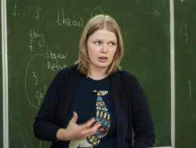
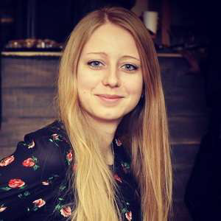
PICASA: BSUIR OUTPUTS
WP3: Operationalization of internationalization
3.1.Revised 2 academic programmes per HEI
1st degree programme ‘Marketing in E-Commerce’
Guest professors/experts:
March, 2016 – L. Kiseleva, IM Action, Lecture on doing digital marketing for Western markets
February, 2016 - E. Beloozerova, ARTOX media Moscow, seminar on Internet marketing

Slide 7
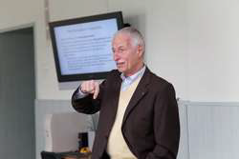
PICASA: BSUIR OUTPUTS
WP3: Operationalization of internationalization
3.1.Revised 2 academic programmes per HEI
1st degree programme ‘Marketing in E-Commerce’
Guest professors/experts:
October, 2014 - Dr. J. Westover, Utah University, lecture on employees motivation
May, 2014 - Video-conferencing with Samara State Technical
University
March, 2014 - Prof. Dr. V. Ronge, Wuppertal University, seminar on cultural management

Slide 8
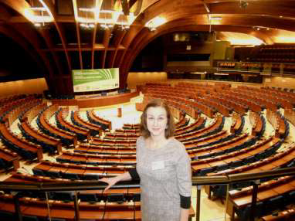
PICASA: BSUIR OUTPUTS
WP3: Operationalization of internationalization
3.1.Revised 2 academic programmes per HEI
1st degree programme ‘Marketing in E-Commerce’
Trainings abroad (faculty&students):
– Pforzheim, Germany, 2013
– Mittweida, Germany, 2014
– Brussels, Belgium, 2015
– Bialystok, Poland, 2016

Slide 9
PICASA: BSUIR OUTPUTS
WP3: Operationalization of internationalization
3.1. Revised 2 academic programmes per HEI
Master degree programme ‘Information Security in Telecommunications’
Teaching foreign students from Libya, Iraq, Iran, Nigeria, Turkmenistan in English language

Slide 10
PICASA: BSUIR OUTPUTS
WP3: Operationalization of internationalization
3.1. Revised 2 academic programmes per HEI
Master degree programme ‘Information Security in Telecommunications’
Revision of syllabi ‘Protection of Telecommunication Sites from Unauthorized Access’:
- Student learning outcomes (to master internationally recognized Information Security Management approaches)
Teaching and learning activities (international IS principles with reference to domestic legislations; e-tutorials in English; mixed group work; glossaries of technical terms in domestic languages; intercultural groups and discussions; application of digital communication technologies (web-site, google-forms, google-disk)

Slide 11
PICASA: BSUIR OUTPUTS
WP4: Quality Control and Monitoring
4.1.Quality control and monitoring plan and tools
Feedback done before and after each staff training
4.2.Report on WPs achievements
Reports on every 6-months results presented to national government bodies, 12-months - to CESIE
Monitoring reports (experts’ site visit, E+ National Office, grantholder’s visits)
4.3.Annual monitoring reports by the grantholder and EU partners
financial report for 2014 presented by January 2015
financial report for 2015 is under processing

Slide 12
PICASA: BSUIR OUTPUTS
WP5: Dissemination
5.1.Project web-site
Project page done at BSUIR web portal
5.2.Raised awareness through two annual conferences and mass media
News published at BSUIR web portal & IRO Facebook page
Scientific articles published in conference proceedings
Project achievements presented at information days in BSUIR
Participation in 1st Conference on internationalization in higher education PICASA-2015 (19-20.11.2015, Armenia)

Slide 13
PICASA: BSUIR OUTPUTS
WP6: Sustainability
6.1. Adoption of internationalization framework by HEIs
BSUIR Policy on Internationalization is developed & integrated into BSUIR Development Programme for years 2016-2020 (approved by University Council in Jan 2016)
Adopted BSUIR local acts regulating:
- student exchange between BSUIR and L.N.Gumilyov Eurasian National University (Kazakhstan)
competitive selection of participants for Erasmus+, КА1

Slide 14
PICASA: BSUIR OUTPUTS
WP7: Management of the project
7.1.Efficient & effective project implementation
Kick-off meeting on 21-24.01.2014
A.Osipov included into Project Governing Board by 07.02.2014
Project national approval and Project Management Committee by August 2014
BSU appointed as local country coordinator
Regular coordination meetings, etc.

Slide 15
PICASA: РЕЗУЛЬТАТЫ БГУИР
TOTAL spent by BSUIR within the reporting period: 16 869 евро (Tempus grant)
Source of funding | Total project budget, Euro | Total spent, Euro
Donor (EU budget) | 42 510,72 | 16 869,43
Co-financing (BSUIR budget) | 4 871,02 | 0

